Slide 1
Beehive Nominees
2015-2016

Slide 2
Beehive Picture Book List
2015-2016

Slide 3
Battle Bunny
by
Jon Scieszka and Mac Barnett
Illustrated by Matthew Myers
Alex transforms a sappy book into a story all his own.

Slide 4
Get some used books that the kids can write all over to make their own story.
Talk about book mash ups
http://mybirthdaybunny.com/wp-content/uploads/2013/09/Battle-Bunny-Guide.pdf
(Questions and activities)

Slide 5
Because I Stubbed My Toe
by
Shawn Byous
A stubbed toe sets off a chaotic chain reaction.

Slide 6
Talk about cause and effect
Pair the book with “If you give a mouse a cookie” by Laura Numeroff
http://www.scasl.net/assets/BookAwards/pba_activity_guides.pdf
http://www.readworks.org/lessons/grade1/cause-and-effect

Slide 7
Buddy and the Bunnies in:
Don’t Play With Your Food
by
Bob Shea
Buddy wants to eat bunnies until they become friends.

Slide 8
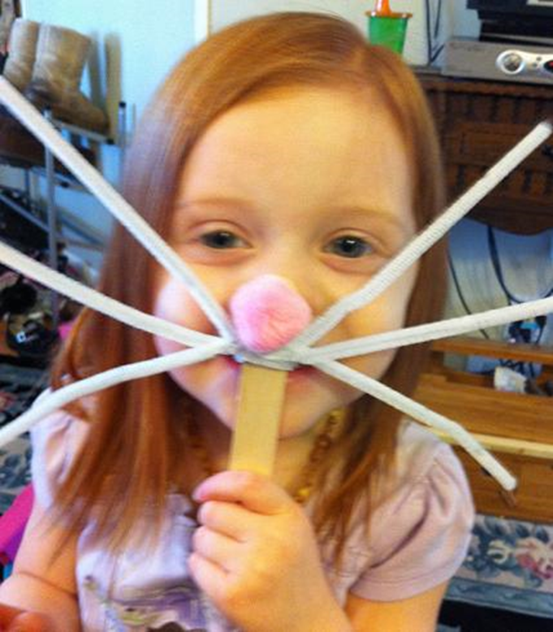
Bunny ear crafts
http://www.teachingbooks.net/tb.cgi?tid=37017&a=1
http://molib.org/wp-content/uploads/2015/02/Activity-Sheet-2015-Buddy-and-Bunnies.pdf

Slide 9
The Girl and the Bicycle
by
Mark Pett
A wordless book about working hard to earn something you want.

Slide 10
Talk about wants vs. needs
Saving Money and budgeting
Make a piggy bank
Talk about wordless picture books
Make their own wordless picture book
http://www.vermonttreasurer.gov/sites/treasurer/files/pdf/literacy/2014%20Girl%20%26%20Bicycle%20LA.pdf
http://www.vermonttreasurer.gov/sites/treasurer/files/pdf/literacy/2014%203-4%20grades%20lesson.pdf

Slide 11
How to Babysit a Grandma
by
Jean Reagan
Illustrated by Lee Wildish
Presents instructions for properly babysitting a grandmother.

Slide 12
http://www.randomhousekids.com/media/activities/HowBabysitGrandma_Activities.pdf

Slide 13
I’m a Frog!
By
Mo Willems
Piggie and Gerald discover the world of pretend.

Slide 14
Learn about frogs
Talk about pretending and do some pretending exercises
Students can read and act the book out

Slide 15
I’m My Own Dog
by
David Ezra Stein
Dog is fine on his own until he gets an itch he can’t reach.

Slide 16
Students can make dog tags
Do some animal yoga
http://bookweekonline.com/system/files/123/original/ImMyOwnDog_StoryHourKit.compressed.pdf
http://molib.org/wp-content/uploads/2015/02/Activity-sheet-2015-Im-My-Own-Dog.pdf

Slide 17
Maple
by
Lori
Nichols
Maple learns how to accept her baby sister.

Slide 18
Leaf art
Go on an outdoor scavenger hunt
Learn to identify tree leaves
http://www.lorinichols.com/Lori_Nichols/MAPLE_files/leafidentification%202.pdf
http://lorinichols.com/Lori_Nichols/MAPLE_&_WILLOW_TOGETHER_files/M%26W_APART_ACTIVITY_WEB.pdf

Slide 19
The Odd One Out: A Spotting Book
by
Britta Teckentrup
Find the odd one out in each animal search-and-find puzzle.

Slide 20
Students can try drawing a picture of their own
http://www.tefl.net/esl-lesson-plans/esl-activities-oddoneout.htm

Slide 21
Picture Day Perfection
by
Deborah Diesen
Illustrated by Dan Santat
A young boy plans all year to have the most terribly perfect school picture.

Slide 22
Make masks or funny props that the students can take their picture with
Fake a bad picture with a camera
cool iPad app for filmstrip photos, snap shots of your kiddos faking a “bad picture day” moment. They LOVE this. Have them mess their hair up, make their clothes look sloppy, and have the worst faces EVER in the photos you snap.

Slide 23
This is a Moose
by
Richard T. Morris
Illustrated by
Tom Lichtenheld
Moose dreams big, even when it gets in the way of the movie director’s vision.

Slide 24
Use a camera or iPad to make their own documentary
Draw a picture of their dream or what they want to be when they grow up
Science Craters on the moon activity. Students will drop meterors (rocks) on the moon (flour and baby oil in tin tub) and see what happens.
Learn about astronauts
Film each student explaining what they want to do in the future and how they will accomplish it.
http://www.islma.org/Monarch-2016-files/islma/ThisIsAMoose.pdf

Slide 25
The Tooth Fairy Wars
By Kate Coombs
Illustrated by Jake Parker
Nathan is determined to stop the tooth fairy from taking his teeth.

Slide 26
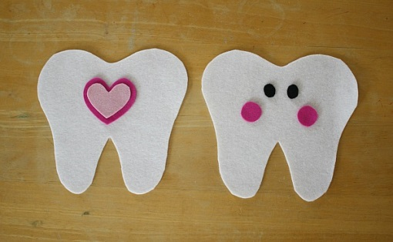
Investigate the Tooth Fairy and the history behind her
Talk about teeth and how to take care of them
Talk about which animals that lose their baby teeth
Tooth Fairy traditions
http://katecoombs.com/TFW.html
http://www.bystephanielynn.com/2012/02/10-tooth-fairy-traditions-and-ideas-tuesday-ten.html?utm_source=feedburner&utm_medium=feed&utm_campaign=Feed%3A%20UnderTheTableAndDreaming%20%28Under%20The%20Table%20and%20Dreaming%29
Make a little pillow to put tooth in

Slide 27
Beehive Children’s Fiction List
2015-2016

Slide 28
The Blood Guard
by
Carter
Roy
Learning that his mother is a member of the secret society, Ronan finds himself on the run for his life.

Slide 29
What would be your special power?
Have the class draw their own logo.
In The Blood Guard, Jack Dawkins is almost 200 years old. What would it be like to live for 200 years untouched by time? Compare and contrast how things have changed and what has remained the same.
http://www.teachingbooks.net/media/pdf/Amazon/BloodGuard_ActivityGuide.pdf (Activity guide with lots of fun stuff.

Slide 30
El Deafo
by
Cece Bell
After Cece loses her hearing, she discovers her superpower when she uses the Phonic Ear.

Slide 31
Research hearing aids and their history.
Research Meningitis
http://www.abramsbooks.com/academic/El_Deafo_TeachingGuide.pdf (Teaching Guide)
http://disabilitygames.blogspot.com/2010/06/welcome-to-disability-games-website.html (Games to teach with)
Play games that illustrate what it would be like to have a disability:
Have the class play a game based on the popular game Telestrations (Telephone game). Each student or group starts with a sketch book, marker and word card. The timer gets turned and the first person draws their word from the card. After 60 seconds, they pass the book to the player on their left. The next student takes a few seconds to guess in words(s) what they see, and passes again. The next student draws the guess.This continues until everyone has had a chance to make a guess. It’s time for The Big Reveal. Everyone shares the book and the hilarious miscommunication is revealed.

Slide 33
The Fourteenth Goldfish
by
Jennifer L. Holm
Ellie’s life gets complicated when her grandfather discovers how to reverse aging.

Slide 34
Talk about the history of medicine.
Explore different scientists mentioned in the book; Curie, Salk, and Oppenheimer.
http://freesciencefairproject.com/projects/mold_experiment.html (Experiment on mold)
http://globalreadaloud.wikispaces.com/Fourteenth+Goldfish+Page
This website contains a lot of information including a teaching guide, classroom predictions, science articles, articles on jellyfish, videos, etc.

Slide 35
Frostborn
by
Lou Anders
When a family tragedy strikes, Karn flees into the wilderness where he befriends a young frost giant.

Slide 36
http://www.thronesandbones.com/content/uploads/2014/07/Frostborn_Educator_Guide.pdf (Guide)
Do a Vikings project
Make your own board game like the one in the book.
Make a map from the story.
Character sketches.
Make up your own Viking Village.
Make a playlist for the book.

Slide 37
The Great Trouble:
A Mystery of London, the Blue Death, and a Boy Called Eel
by
Deborah Hopkinson
In 1854 a young orphan assists Dr. Snow to find the cause of the cholera outbreak in London.

Slide 38
Look at the World Health Organization and the Centers for Disease Control and Prevention (cdc.gov).
What is the role of each organization in managing epidemics and pandemics? What are some current epidemics?
http://www.randomhouse.com/teachers/wp-content/uploads/2013/07/GreatTrouble_EG_WEB.pdf
http://classroombookshelf.blogspot.co.uk/2013/10/the-great-trouble-mystery-of-london.html
http://www.teachingbooks.net/media/pdf/YHBA/GreatTrouble.pdf

Slide 39
Loot:
How to Steal a Fortune
by
Jude Watson
March uncovers family secrets when his burglar father meets an untimely end.

Slide 40
Do a jewelry making craft.
Scavenger hunt to find the treasure. The students can draw a map to get to it.
http://www.scholastic.com/bookfairs/sites/default/files/pdfs/349185_loot.pdf
http://www.scholastic.com/teachers/lesson-plan/discussion-questions-loot-jude-watson

Slide 41
Two Irish orphans face an ancient curse when they begin work at a crumbling English manor.

Slide 42
http://www.teachingbooks.net/tb.cgi?tid=41123&a=1
(Reader’s Theater and discussion questions)
https://suzyred.com/The-Night-Gardener.html
(Scary stories that go with the story)
Have students write a review and then post it to Goodreads

Slide 43
Spell Robbers
by
Matthew J. Kirby
Ben is drawn into danger when he learns how to change reality at science camp.

Slide 44
Do a science camp with multiple experiments.
http://www.scholastic.com/teachers/lesson-plan/discussion-questions-quantum-league-spell-robbers-matthew-j-kirby

Slide 45
Under the Egg
by
Laura Marx Fitzgerald
Theodora must find the hidden treasure that could save her family.

Slide 46
http://www.lauramarxfitzgerald.com/
The author has a lot of fun stuff on her website
that goes with the books. For example, art
history links, information on Raphael the famous
painter, and crafts (window sun cathers out of
leaves)
Lots of craft ideas:
Decorate eggs
Paint landscapes

Slide 47
The Vanishing Coin
by
Kate Egan & Mike Lane
Fourth grader Mike Weiss finds his talent at the White Rabbit magic shop.

Slide 48
Have the students learn and perform magic tricks
https://docs.google.com/document/d/1yTE8-E9JZYBvqIC-PTwQFUeetr3OWoannmARJrA_Vyo/edit?pli=1
(Readers theater)
Coin magic trick

Slide 49
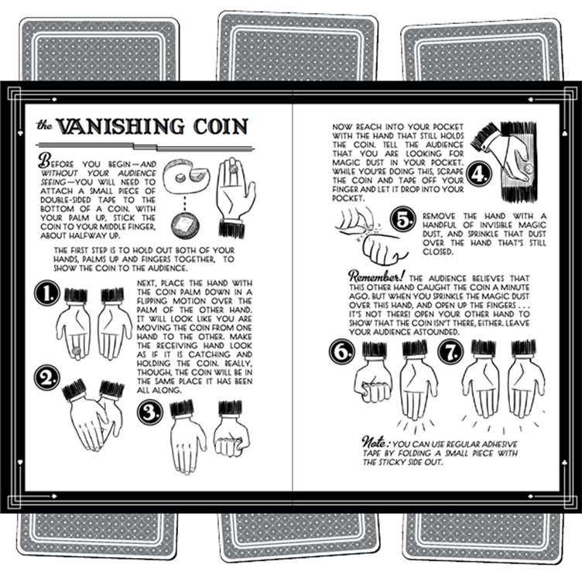

Slide 50
Beehive Informational Book List
2015-2016

Slide 51
Bone by Bone:
by
Sara Levine
Illustrated by
T. S. Spookytooth
Examines how skeletons are the same yet different.

Slide 52
Compare skeleton of cat to human skeleton
http://www.infovisual.info/02/067_en.html
Use as puzzle
Play a skeleton matching game
http://www.sciencekids.co.nz/gamesactivities/movinggrowing.html
Make dinosaur pasta skeletons
https://www.pinterest.com/pin/525795325224043510/

Slide 53
Eruption!: Volcanoes and the Science of Saving Lives
by
Elizabeth Rusch
Photographs by
Tom Uhlman
Follows the scientists of the International Volcano Crisis Team.

Slide 54
Create a soda/mentos geyer
https://www.pinterest.com/pin/501940320948176312/
Discussion of Tetonic plates
https://www.pinterest.com/pin/289778557252472954/
Make your own lava bed
https://www.pinterest.com/pin/151574343686577258/

Slide 55
Fighting Fire:
Ten of the Deadliest Fires in American History and How We Fought Them
by
Michael L. Cooper
Chronicles how ten deadly fires lead to new firefighting techniques and technology.

Slide 56
Discussion of Fire safety tips
http://www.educationworld.com/a_lesson/lesson/lesson026.shtml
Fire safety activities and worksheets
http://seasonal.theteacherscorner.net/fire-prevention/
http://busyteacher.org/teaching_ideas_and_techniques/emergency/fire-safety-worksheets/

Slide 57
Hot Dog! Eleanor Roosevelt Throws a Picnic
by
Leslie Kimmelman
Illustrated by
Victor Juhasz
In 1939 Eleanor Roosevelt knows the perfect way to entertain the King and Queen of England.

Slide 58
Activity kit from Sleeping Bear Press
http://www.teachingbooks.net/media/pdf/SleepingBearPress/HotDog_ActivityGuide.pdf
Create a sample menu for a visiting dignitary similar to Eleanor Roosevelt’s
http://www.fdrlibrary.marist.edu/aboutfdr/pdfs/royal_picnicmenu.pdf
Create an invitation like FDR did in 1939
http://www.fdrlibrary.marist.edu/aboutfdr/pdfs/royal_fdrinvitation.pdf

Slide 59
How Big Were Dinosaurs?by
Lita Judge
Not all dinosaurs were really big, in fact some were very small.

Slide 60
Write a funny dinosaur poem
http://www.enchantedlearning.com/subjects/dinosaurs/classroom/Poem.shtml
Dinosaur Worksheets for various dinosaurs
http://www.activityvillage.co.uk/dinosaur-worksheets
Play dinosaur tag
http://www.teachingideas.co.uk/pe/dinosaurtag.htm

Slide 61
Imprisoned: The Betrayal of Japanese Americans During World War II
by
Martin W. Sandler
An in-depth look at the lives of Japanese-Americans after the bombing of Pearl Harbor.

Slide 62
Connect food with stories
http://amhistory.si.edu/ourstory/pdf/internment2/internment_play.pdf
Honoring Japanese Americans
http://amhistory.si.edu/ourstory/pdf/internment2/internment_object.pdf
Real People, Real Stories
http://amhistory.si.edu/ourstory/pdf/internment2/internment_tech.pdf
https://zinnedproject.org/materials/a-lesson-on-the-japanese-american-internment/

Slide 63
Millions, Billions, & Trillions:
Understanding Big Numbers
by
David A. Adler
Illustrated by
Edward Miller
Shows concrete examples of very large numbers.

Slide 64
Compare Millions, Billions & Trillions
https://emccss.everydaymathonline.com/emcrosswalk/pdf/5/g5_tlg_Lesson_2_10_mm_page_66B.pdf
Bulls Eye Game
Divide the students into pairs to play this game.
Draw a large bull’s-eye on a 2X2 square piece of cardboard. Label as follows: 1. Inside circle, millions; 2. Next circle, thousands; 3. Next circle hundreds; 4. Next circle, tens; 5. Last circle, ones.
Let students pitch 25 paperclips at the bulls-eye and then figure out their score by adding up the numbers. Have them use expanded notation first, and then write the number. For example,
2,000,000 + 6,000 + 500 + 40 + 8 = 2, 006, 548.
If the students have difficulty adding their numbers, have them use their place value charts.
Whoever has the largest number wins.
http://lessonplanspage.com/mathplacevalue4th-htm/

Slide 65
Mr. Ferris and His Wheel
by
Kathryn Gibbs Davis
Illustrated by Gilbert Ford
In a magnificent feat of engineering, George Ferris creates a giant wheel for the 1893 World’s Fair.

Slide 66
Build a Big Wheel
http://teachers.egfi-k12.org/build-a-big-wheel/
Inspiration
http://www.teachingbooks.net/media/pdf/HMH/Davis_MrFerrisAndHisWheel_TG.pdf
Show your community to the world
http://publications.newberry.org/k12maps/module_17/6-8.html

Slide 67
Separate is Never Equal: Sylvia Mendez and Her Family’s Fight for Desegregation
by
Duncan
Tonatiuh
Syliva and her family fight to end school segregation in California.

Slide 68
Persuasive Letter About Fairness in School & History of School Desegregation
http://www.adl.org/assets/pdf/education-outreach/book-of-the-month-separate-is-never-equal.pdf
http://www.booklistreader.com/2014/07/07/bookends-childrens-literature/separate-is-never-equal-by-duncan-tonatiuh/

Slide 69
Tiny Creatures: The World of Microbes
by
Nicola Davies
Illustrated by Emily Sutton
The tiniest living organisms all work hard to change things.

Slide 70
Pathologist visit
Microbes in Yogurt
Microbes in Compost
http://classroombookshelf.blogspot.com/2014/11/tiny-creatures-world-of-microbes.html

Slide 71
Beehive Poetry Book List
2015-2016

Slide 72
Dust of Eden
by
Mariko
Nagai
A novel in verse about Mina and her family who are sent to an internment camp in Idaho.

Slide 73
Study Japanese History
Great Pictures of the camps
Study Internment camps
Talk about what a novel in verse
Study the internment camp at Topez in Utah

Slide 74
Hi, Koo:
A Year of Seasons
by
Jon
Muth
Twenty-six haikus about the four seasons presented by a panda bear named Koo.

Slide 75
http://classroombookshelf.blogspot.co.uk/2014/04/firefly-july-and-hi-koo-poems-about.html
(All sorts of ideas to teach this book)
Teach and practice haiku poetry
Learn about the seasons and the differences
http://joannamarple.com/2014/04/hi-koo-a-year-of-seasons-perfect-picture-book-friday/
(Videos and lessons that apply to the book

Slide 76
Ode to a Commode: Concrete Poems
by
Brian P.
Cleary
illustrated by
Andy Rowland
Find the objects in these poems shaped just like their inspiration.

Slide 77
http://www.brianpcleary.com/
(Author website)
Students can create their own concrete poetry

Slide 78
The Pet Project:
Cute and Cuddly Vicious Verses
by
Lisa Wheeler
illustrated by
Zachariah OHora
An analytical young girl plans out a scientific experiment in order to find the perfect pet.

Slide 79
Vote for a classroom pet (use a stuffed animal or have a drawing contest)
http://www.lisawheelerbooks.com/LW/Pet_Project.html
(Author website)

Slide 80
Poem Depot:
Aisles of Smiles
by
Douglas
Florian
A collection of humorous poems.

Slide 81
Each student will choose one poem to practice reading aloud. The student will focus on line breaks, voice, timing, and portraying the feeling of the poem. After the student has taken the time to choose a poem and practiced reciting it, the students will find a partner and take turns reciting each other’s poems for one another.

Slide 82
Prince Puggly of Spud:
And the
Kingdom of Spiff
by
Robert P.
Weston
Poorly dressed Prince Puggly finds that he can teach the well-dressed people in Spiff a little something.

Slide 83
http://americarunsonreading.blogspot.com/2013/10/prince-puggly-of-spud-and-kingdom-of.html
http://www.literaryfusions.com/2015/07/02/book-review-prince-puggly-of-spud-and-the-kingdom-of-spiff-by-robert-paul-weston/

Slide 84
Under the Freedom Tree
by
Susan VanHecke
illustrated by
London Ladd
In 1861 slaves find freedom in a Union-held fort by building their own community.

Slide 85
Research slavery
http://www.underthefreedomtree.com/underthefreedomtree_readers.pdf (Reader’s theater)
http://www.underthefreedomtree.com/ (Video)

Slide 86
Your Skeleton is Showing: Rhymes of Blunder From Six Feet Under
by
Kurt Cyrus
illustrated by
Crab Scrambly
A walk through a graveyard allows a boy and a dog to discover the stories of the residents’ demise.

Slide 87
http://www.teacherplanet.com/resource/skeletal.php (Website to learn all about the skeletal system
http://www.kurtcyrus.com/yourskeleton.html
(Author website)

Slide 88
Beehive Young Adult Book List
2015-2016
*indicates more mature content

Slide 89
All the Truth That’s In Me*
by
Julie Gardner Berry
When her town is attacked, Judith must choose to speak secrets long kept buried.

Slide 90
Discuss what the time period of the book could be
http://static.harpercollins.com/harperimages/ommoverride/Berry_%20All_the_Truth_thats_in_Me.pdf

Slide 91
Buzz
Kill
by
Beth
Fantaskey
Millie realizes it is up to her to solve the murder of her high school’s football coach.

Slide 92
Elements of a classic mystery
Compare & contrast with an Agatha Christie novel
http://bethfantaskey.com/

Slide 93
Counting by 7’s
by
Holly Goldberg Sloan
Willow builds new connections with people when her family is unexpectedly killed.

Slide 94
Discuss how it would be to suddenly be part of a family with a different culture
http://www.penguin.com/static/images/yr/pdf/CountingBy7s.pdf
http://www.sweetonbooks.com/all-titles/1003-counting-by-7s.html
https://texasbluebonnetaward2015.wordpress.com/counting-by-7s/
https://texasbluebonnetaward2015.files.wordpress.com/2014/02/rtcountingby7s-2.pdf - reader’s theater script
https://sixtraitgurus.wordpress.com/2014/03/05/counting-by-7s/
www.state.lib.la.us/files/LYRC/Counting_by_7s.docx

Slide 95
Grandmaster
by
David
Klass
Daniel gains insight about his father when they compete together in a chess tournament.

Slide 96
Learn the basics of chess
Have a chess competition and discuss the pressures of competition
http://teenlitrocks.com/2014/02/27/qa-interview-grandmaster-author-david-klass/

Slide 97
If We
Survive
by
Andrew
Klavan
On a service trip, Will and his companions are trapped in the middle of a revolution.

Slide 98
Talk about different revolutions in Central America or South America
Che Guevara
http://www.needread.net/ebooks/If_We_Survive/Pages_56.html

Slide 99
The Mark of the Dragonfly
by
Jaleigh
Johnson
Piper is drawn into a dangerous world when she rescues a mysterious girl.

Slide 100
Build a robot
http://www.randomhousekids.com/brand/mark-dragonfly/

Slide 101
The
Naturals*
by
Jennifer Lynn Barnes
Cassie joins a group of teenagers who have been recruited by the FBI to solve cold cases.

Slide 102
Profiling
Forensics
History of the F. B. I.
http://www.jenniferlynnbarnes.com/

Slide 103
One Came Home
by
Amy
Timberlake
Georgie is determined to find her sister who everyone else believes is dead.

Slide 104
Causes of the extinction of the passenger pigeon
Wisconsin history
Essay on what you would do for a family member
http://static.squarespace.com/static/503d3bee84aef2a18d298301/t/50dc95c6e4b0c2f49761da1b/1356633542483/OneCameHomeDiscussion%20guide-Timberlake.pdf
http://amytimberlake.com/about-one-came-home/
http://www.randomhouse.com/teachers/resource/one-came-home-educator-guide-with-ccss-tie-ins-2/

Slide 105
The Screaming Staircase
by
Jonathan
Stroud
Lucy and the Lockwood Psychic Investigations Agency combat London’s ghost epidemic.

Slide 106
Discuss if the story takes place in a modern day time or a historical time. What makes it feel more modern/historical?
Are any of the locations mentioned in the book real? Find out if they are by checking a map of London.
http://www.randomhouse.co.nz/content/teachers/The%20Screaming%20Staircase%20Notes%20For%20Readers%20Sep%2013.pdf

Slide 107
Steelheart
by
Brandon
Sanderson
David dreams of defeating the invincible superhuman who murdered his father.

Slide 108
Attributes of a hero vs. a villain
http://www.tomesociety.org/uploads/1/5/5/3/15531344/steelheart_discussion_guide.pdf
ltrc.state.lib.la.us/2016/guides/Steelheart.docx

Slide 109
Tesla’s
Attic
by
Neal Shusterman
The unusual junk in the attic of Nick’s new home brings a lot of trouble.

Slide 110
Learn about Nikola Tesla
http://www.pbs.org/newshour/rundown/5-things-you-didnt-know-about-nikola-tesla/
http://books.disney.com/content/uploads/2014/01/Teslas-Attic-DG-%C2%A6%C3%86.pdf
http://project-middle-grade-mayhem.blogspot.com/2014/02/teslas-attic-interview-with-authors.html

Slide 111
The Tragedy Paper
by
Elizabeth Laban
Their senior thesis has Tim and Duncan reflecting on the previous year’s disasters.

Slide 112
Elements of a tragedy
Shakespeare’s Macbeth
http://novelnovice.com/2013/01/16/qa-with-the-tragedy-paper-author-elizabeth-laban/
https://www.saybrook.edu/newexistentialists/posts/02-08-13

Slide 113
Beehive Winners
2015-2016

Slide 114
Informational Book Nominees 2015

Slide 115
Informational Book Winner
Who Says Women Can’t Be Doctors:
The Story of Elizabeth Blackwell
by Tanya Lee Stone
illustrated by
Marjorie Priceman

Slide 116
Poetry Book Nominees 2015

Slide 117
Poetry Book Winner
National Geographic Book of Animal Poetry:
200 Poems With Photographs
That Squeak, Soar,
and Roar!
edited by J. Patrick Lewis

Slide 118
Picture Book Nominees 2015

Slide 119
Picture Book Winner
Mustache Baby
by Bridget Heos
illustrated by Joy Ang

Slide 120
Children’s Book Nominees 2015

Slide 121
Children’s Book Winner
I Survived Hurricane Katrina, 2005
by Lauren Tarshis

Slide 122
Young Adult Book Nominees 2015

Slide 123
Young Adult Book Winner
Guitar Notes
by Mary Amato

