Slide 1
Beehive Nominees
2018

Slide 2
Beehive Picture Book List

Slide 3
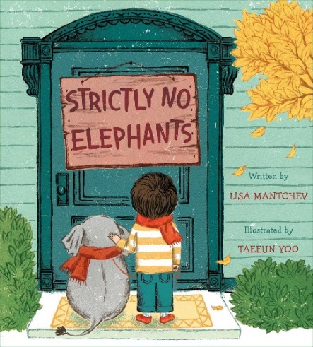
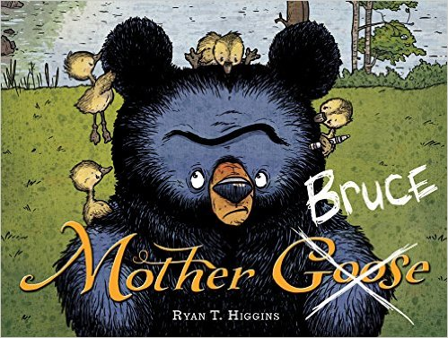
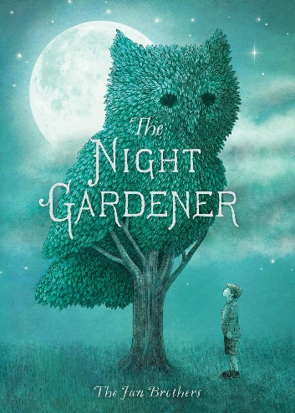
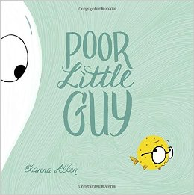
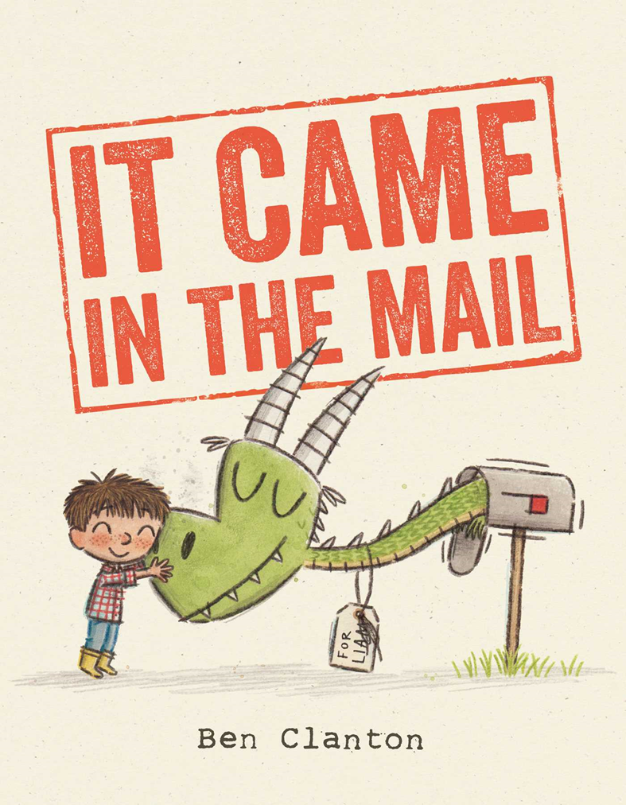

Slide 4
Activities
Paper Plate Goose or Sand Dollar
http://www.daniellesplace.com/html/DuckCrafts.html
http://craftsbyamanda.com/paper-plate-sand-dollars/
“Hibernation” Read-a-thon
How do Geese Migrate?
http://www.birdnature.com/flyways.html

Slide 5
Activities
Tissue paper collage
https://homemadecity.com/2016/03/01/this-picture-book-life-tissue-paper-collage-creature-feature/
Activity packet on Tara Lazar’s website
https://taralazar.files.wordpress.com/2016/03/nnactivitykitlowres.pdf
Make an all about me collage showing the great quatilities you have that make you unique.

Slide 6
Activities
Draw the topiary you would like to see outside your bedroom window.
Plant a seed in a paper cup.
Draw an animal shape or other interesting shape on construction paper. Cut leaves out of green paper and glue them to your drawing to make it look like a topiary.

Slide 7
Beehive Children’s Fiction List

Slide 8
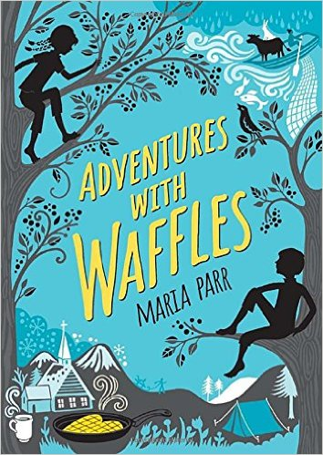
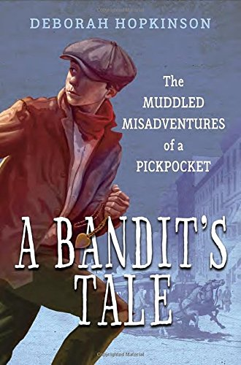
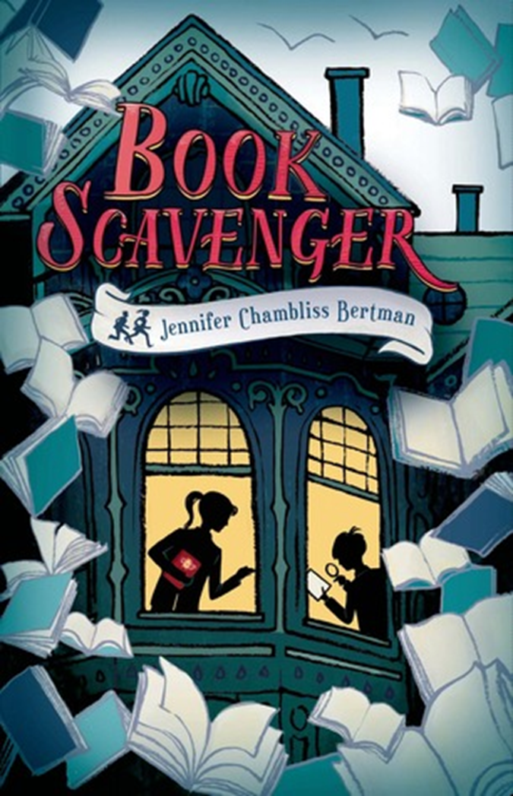
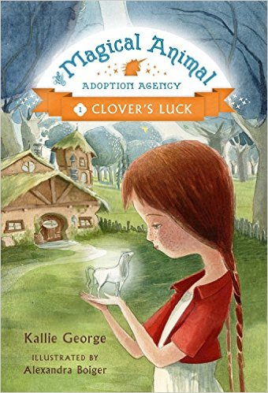
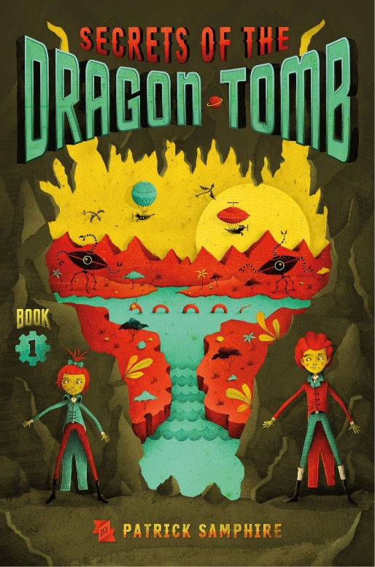
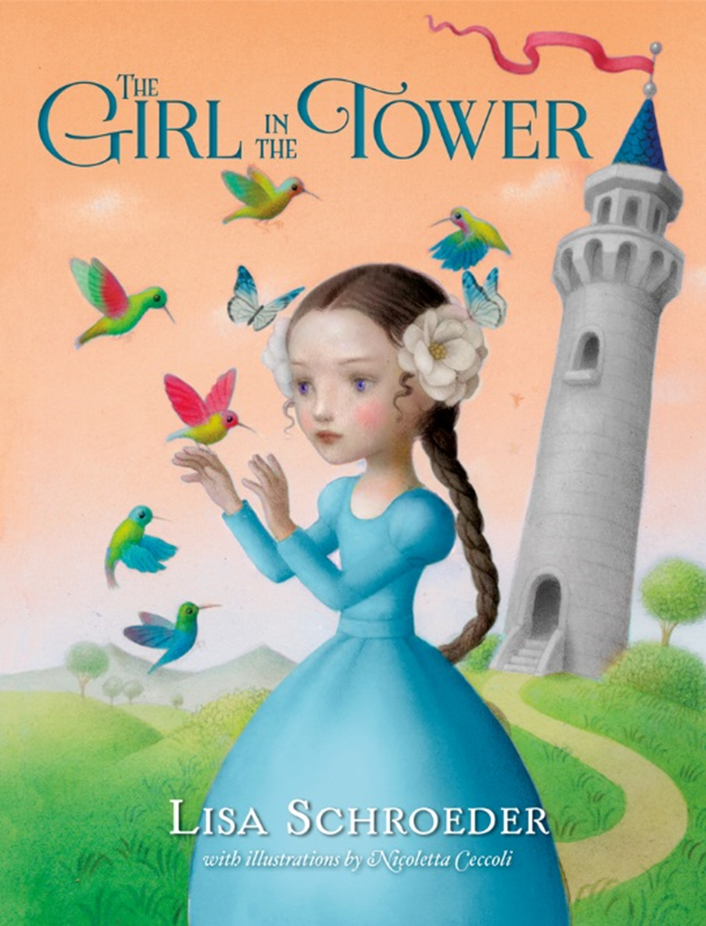
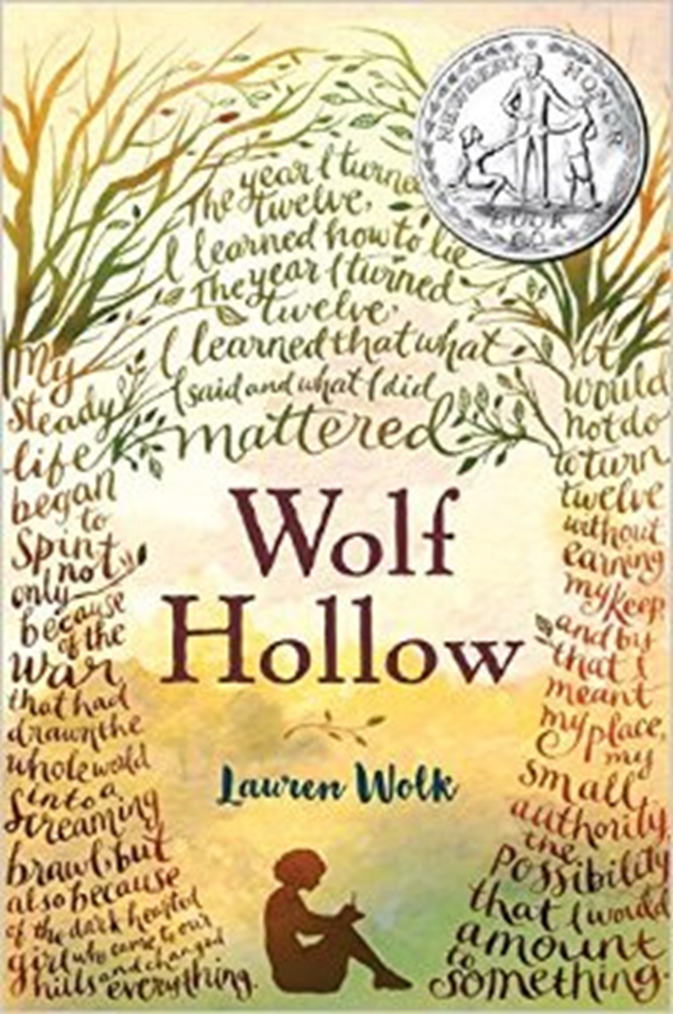
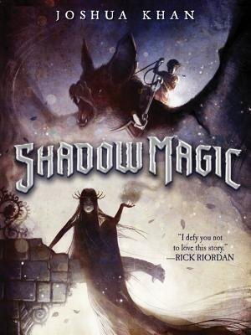

Slide 9
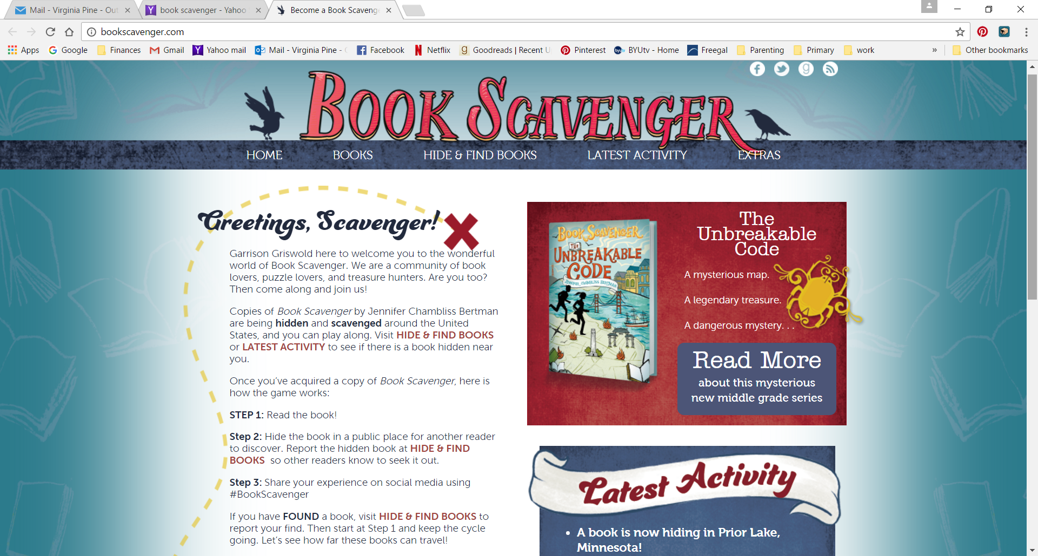
Book Scavenger
Visit www.bookscavenger.com and participate in scaled down version of the Book Scavenger game found in the book! If you would like a similar challenge visit www.bookcrossing.com. This website was part of the inspiration for Book Scavenger. Through this site 1.3 million readers have hidden more than 10 million books!

Slide 10
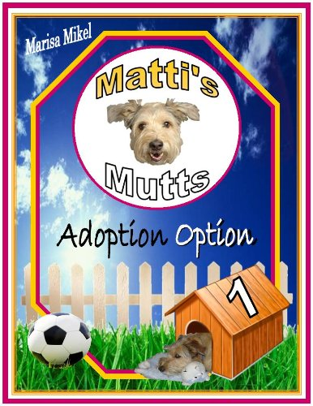
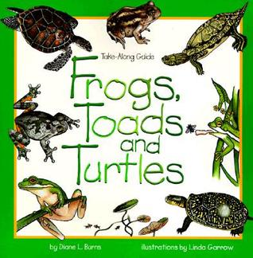
Clover’s Luck
Related Non-fiction
“Adoption Option” (Matti’s Mutts Book1) by Marisa Mikel
“Biscuit” by Ellen Miles
“Frogs, Toads, and Turtles” by Diane L. Burns
“My Limpy Dog: A Dog Adoption Story: A MUST READ, If You Want a Pet, from 8 to 14 to 114 Years Old” (Limpy Dog Series) by Joana Slodownik and Adam Slodownik
“Shelter Dogs: Amazing Stories of Adopted Strays” by Peg Kehret and Greg Farrar
“Slippery Babies: Young Frogs, Toads, and Salamanders” by Ginny Johnston
“The Summer Cat” (Cat Tales Book 3) by Linda Benson

Slide 11
Beehive Informational Book List

Slide 12
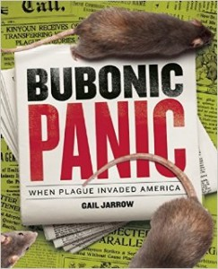
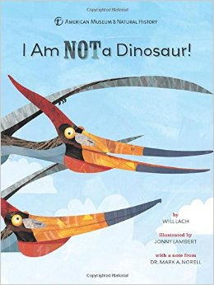
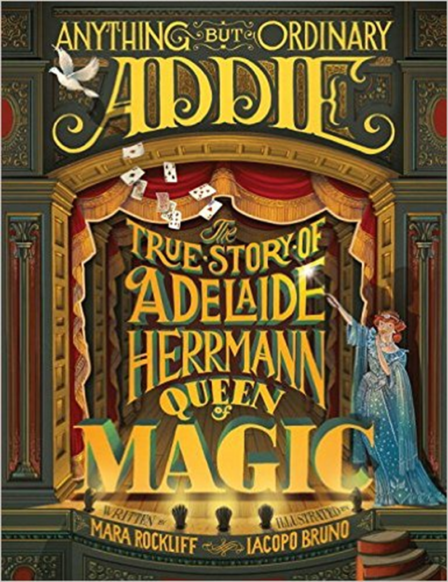
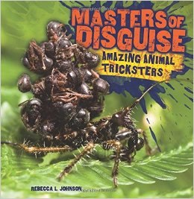

Slide 13
Activities
Super Soaker VS Traditional Squirt Gun: have students take turns squirting a traditional squirt gun and a compressed-air soaker made using one of Johnson’s patents. Measure the distance
Inventor’s Fair: Use the ideas for inventions generated by students during the discussion to hold a mini inventor’s fair.
What’s A Patent: Explore the information found on the US Patent Office’s For Kids page, which includes games and activities, coloring pages. See https://www.uspto.gov/kids/activities.html

Slide 14
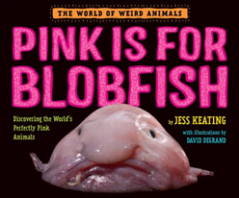
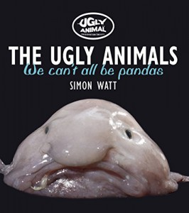
Activities
Make a blobfish out of pink pompoms and Styrofoam.
Share books about other unusual ocean animals
Learn more about strange animals at National Geographic Kids site, http://kids.nationalgeographic.com/explore/nature/ooey-gooey-creepy-crawlies-/
Fun factoid - the Blobfish was voted the ugliest animal by the Ugly Animal Preservation Society

Slide 15
Activities
Learn more about the Recycled Orchestra by watching the 60 Minutes video “The Recyclers: From Trash Comes Triumph” at https://youtu.be/YxUuKthY1dQ
Discover how to make your own musical instruments out of recycled objects! You can get inspiration at How We Learn’s website for activity ideas: http://HowWeElearn.com/Spectacular-Homemade-Musical-Instruments/
Learn about the country of Paraguay by visiting the following websites:
Activity Village at http://ActivityVillage.co.uk/Paraguay
Easy Science for Kids at http://EasyScienceforKids.com/All-About-Paraguay/

Slide 16
Beehive Poetry Book List

Slide 17
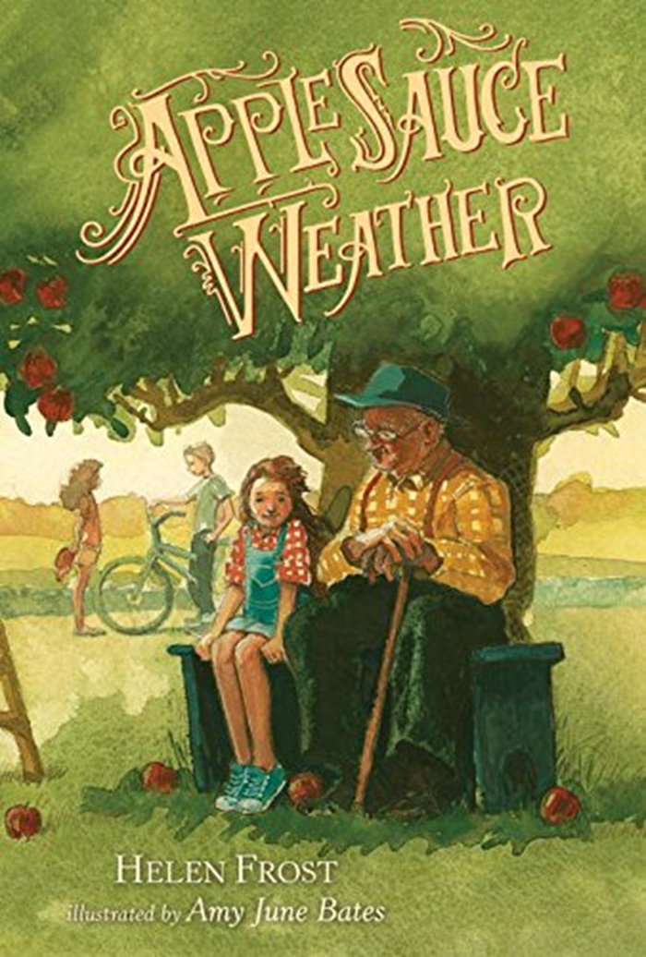
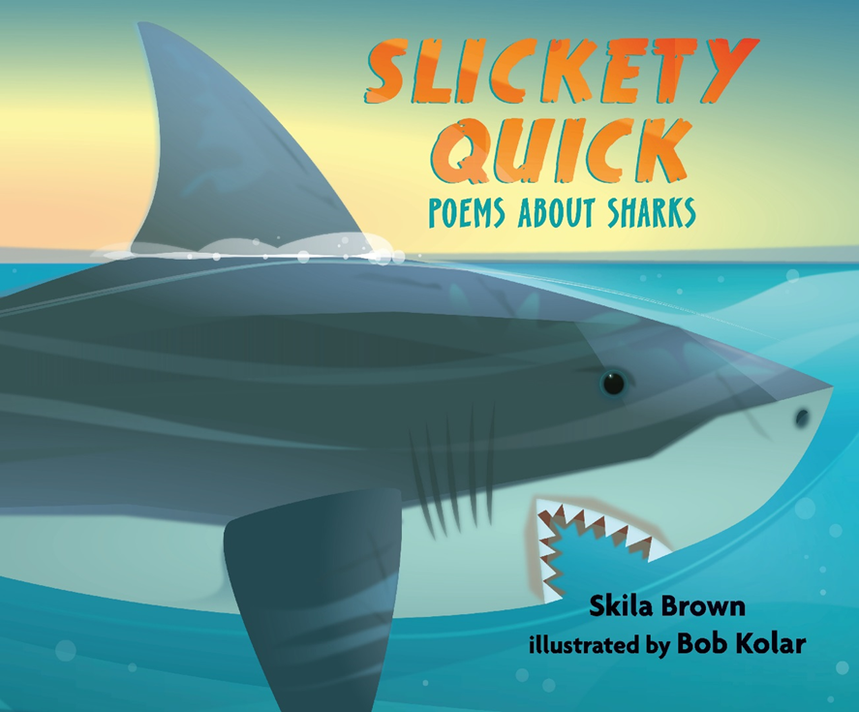
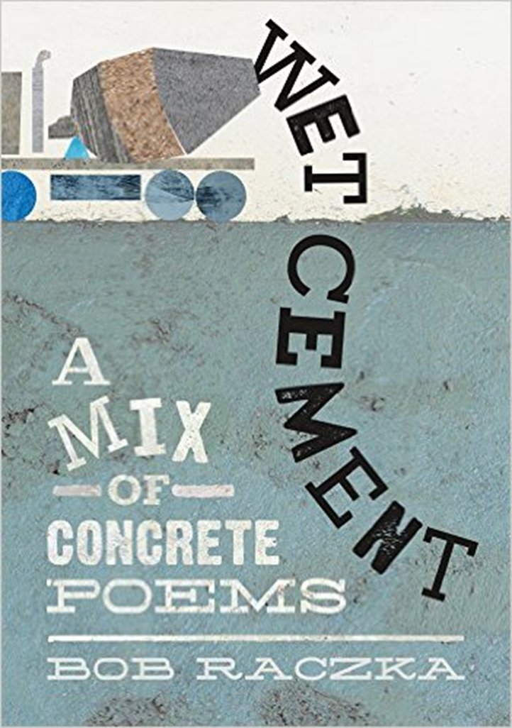
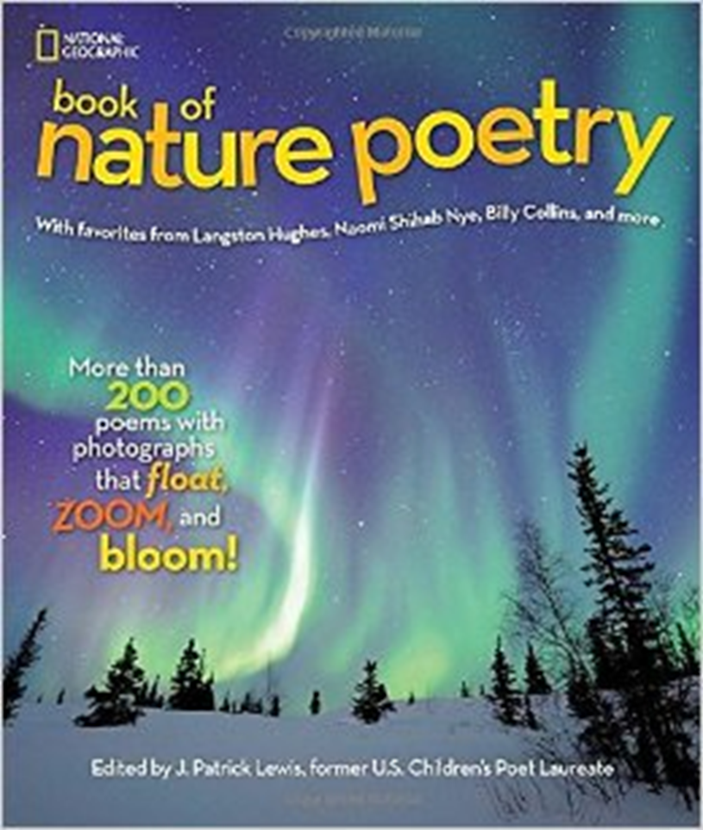
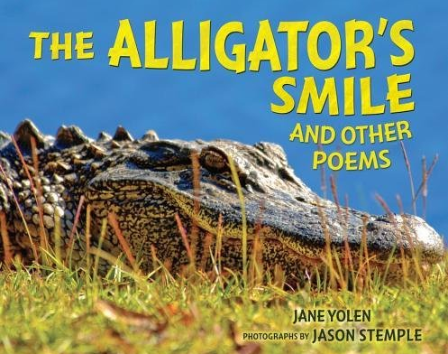

Slide 18
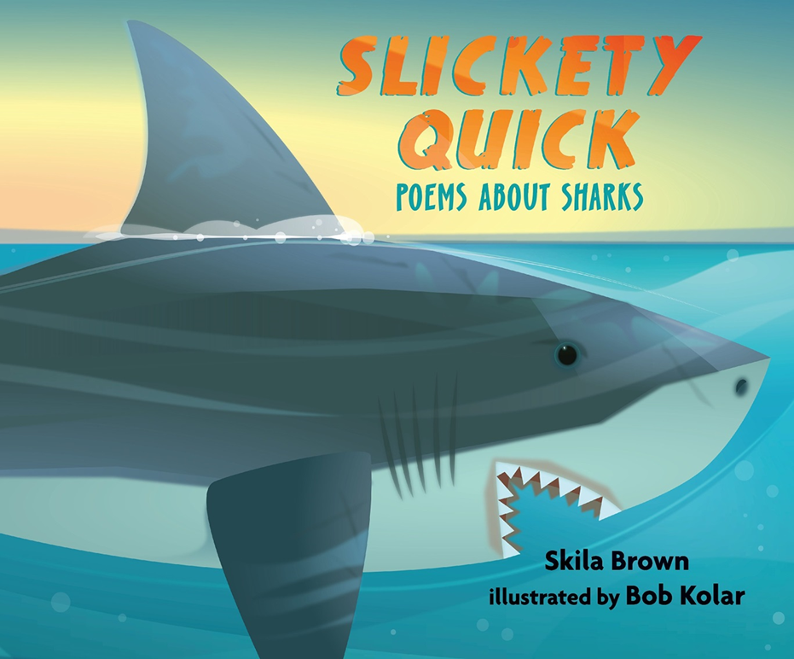

Slide 19
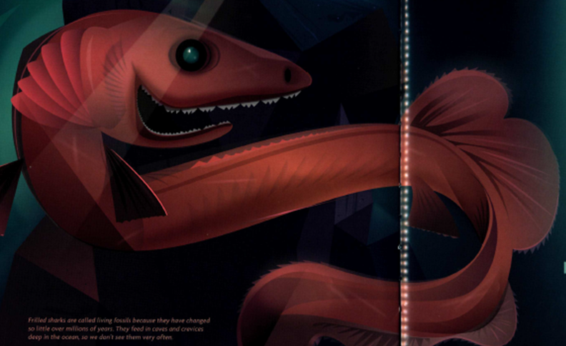

Slide 20
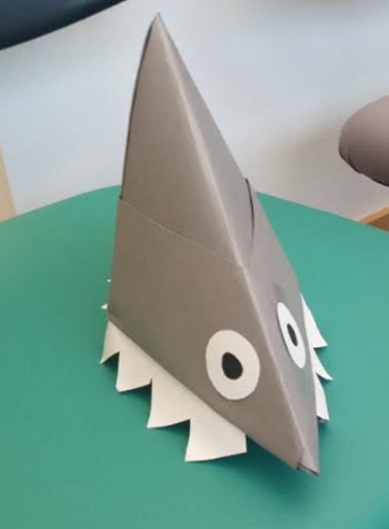

Slide 21
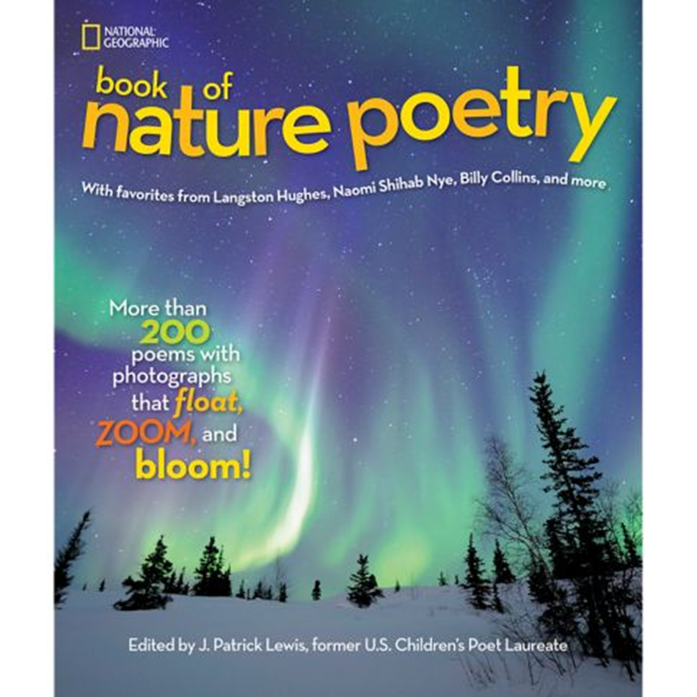

Slide 22
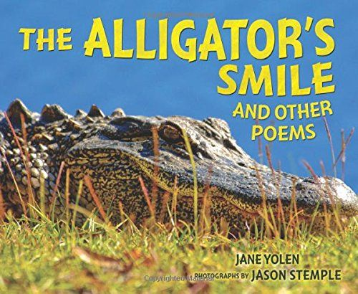

Slide 23
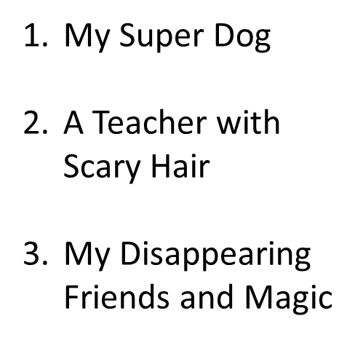

Slide 25
Beehive Graphic Novel List

Slide 26
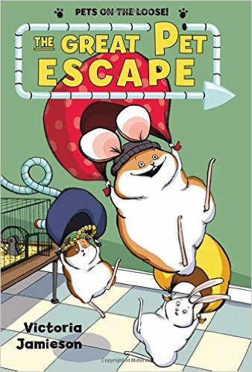
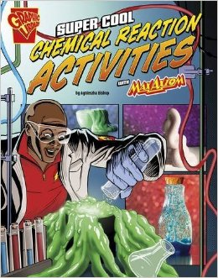
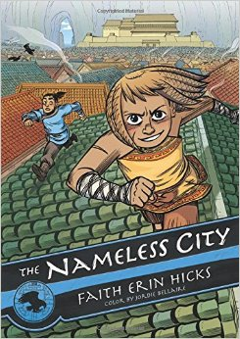

Slide 27
Beehive Young Adult Book List

Slide 28
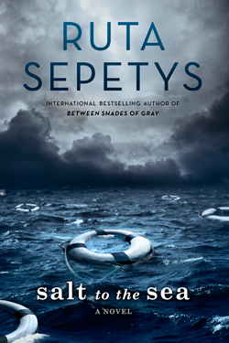
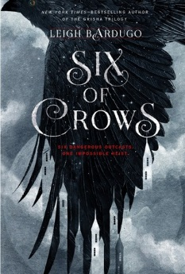

Slide 29
Possible Activities/Lessons:
Malapropisms
https://www.grammarly.com/blog/?s=malapropism
Forms of poetry

